Slide 1
Zero Hour
Time flies but leaves its shadow behind!

Slide 2
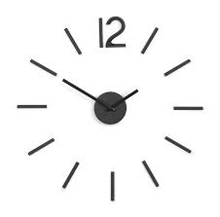
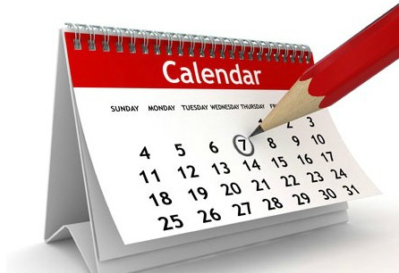
Zero Hour
Give us the date, we will let you know how soon………..

Slide 3
Concept:
You can know the countdown to any future events, if you know the date/time.
Everyone wants to know how far is some events, especially professional & personal.
Busy people.

Slide 4
Process:
Materialize CSS, Moment.js , Jquery plug-ins
Discussed the initial page layout and technologies.
Stanley worked on Materialize CSS. Abi & Cinthia did the changes in layout. We all contributed to different part of the functionality.
Date/Time conversions into milliseconds. And to get current date as today’s date.
All past dates where not accepted in the input, which could have given negative results.

Slide 5

Work flow:
Wireframe
Technologies
Basic page
Logics
Function/Work

Slide 6
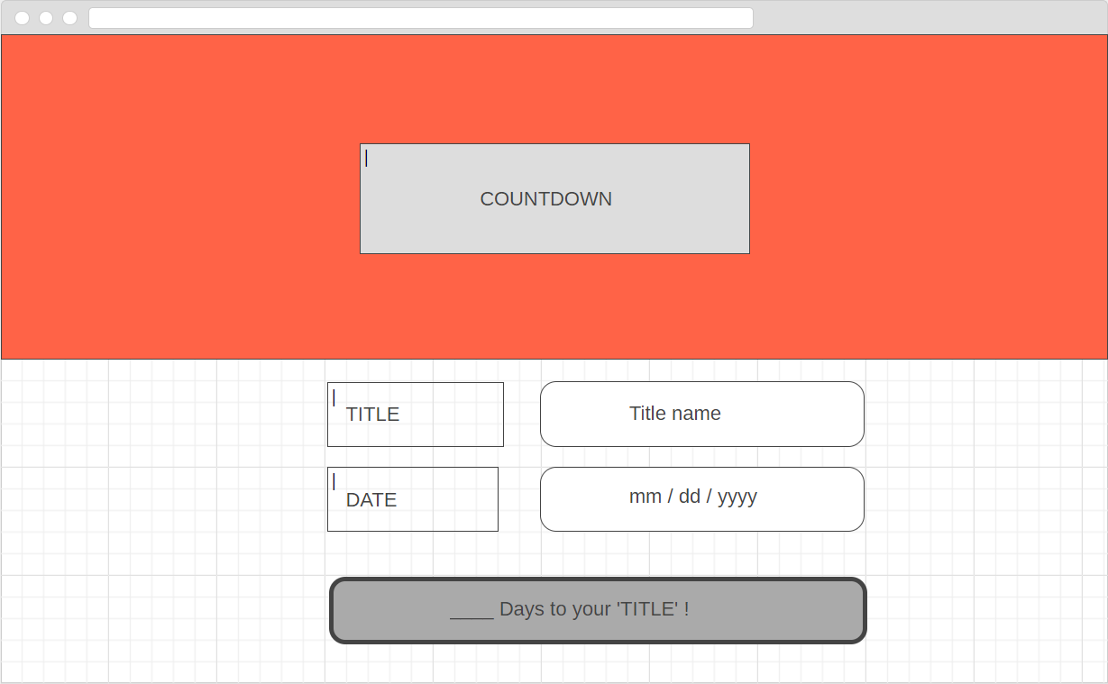

Slide 7
DEMO

Slide 8
Future Developments:
Multiple countdowns
List of Events with pre-fixed dates(like federal holidays)
Reminder for the event via link to device calendar

Slide 9


http://github.com/stanlouis/date-countdown
https://stanlouis.github.io/date-countdown/

